Slide 1
Crop Production in India
Data Analysis and Visualization using Python
[CUTM 1018]
Group B6
Name of Students
  Subhrajeet Nayak
  170301140007
  Rudra Pratap Padhi
  170301140014
Notes:
Qwd’

Slide 2
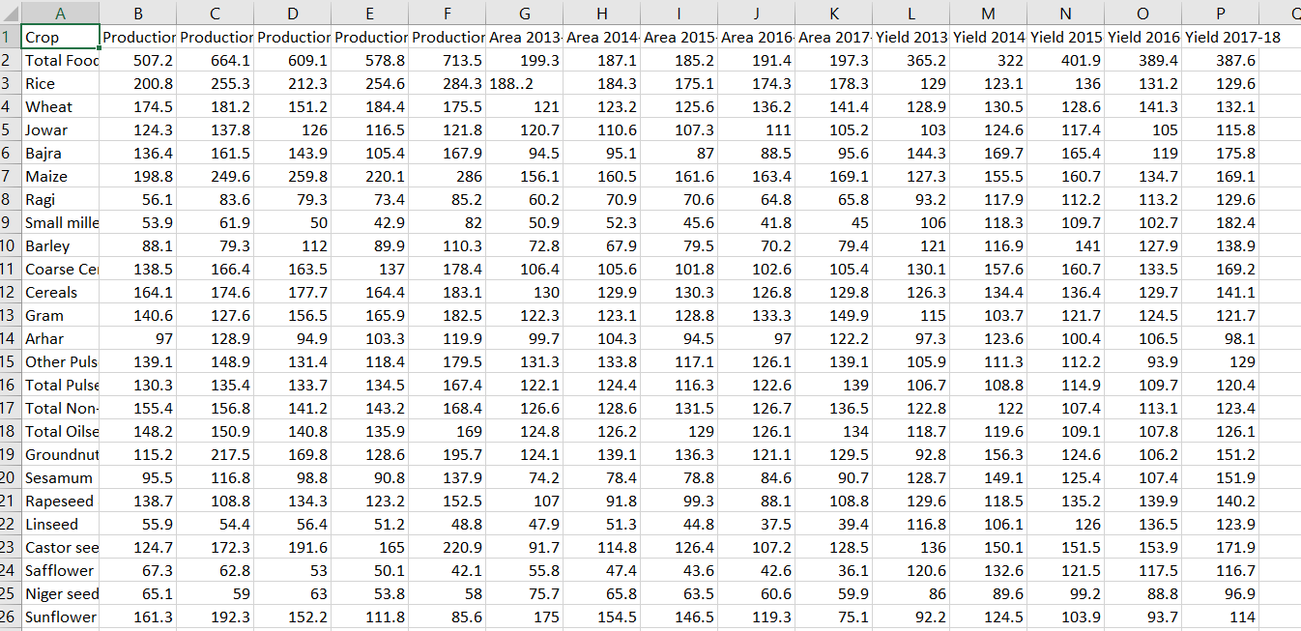
Data Source :
(1)-https://data.world/indoagri/indian-year-wise-crop-production

Slide 3
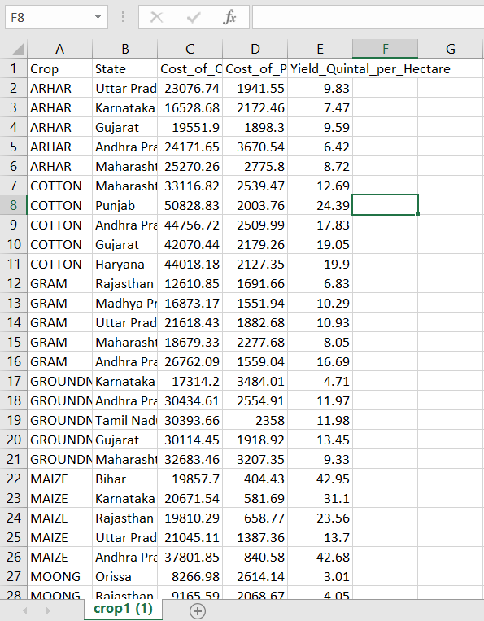
Data Source :
(2)-https://data.world/indoagri/indian-states-wise-crop-production

Slide 4
Objective:
  Visualize the different varieties of Agricultural products.
  Visualize the year wise production of Agricultural Crops.
  Visualize the variations in crops costs and production according State wise .

Slide 5
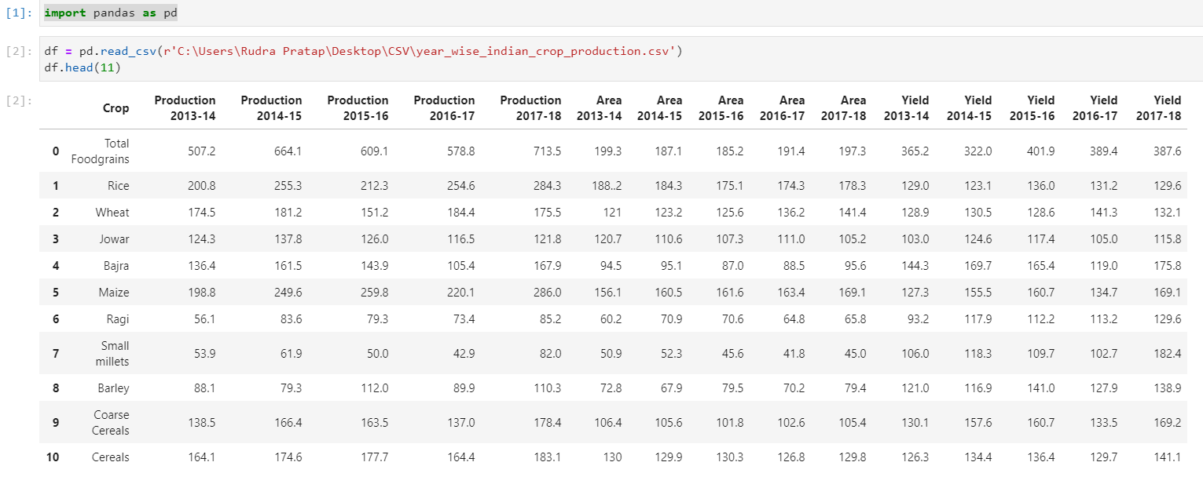
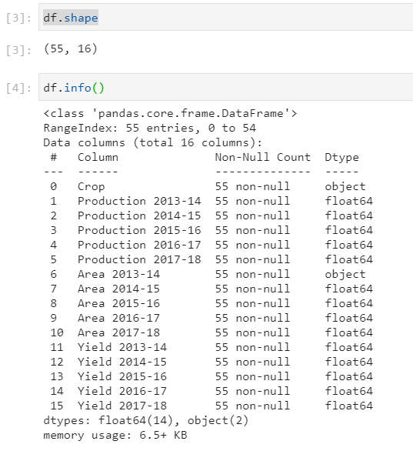

Slide 6
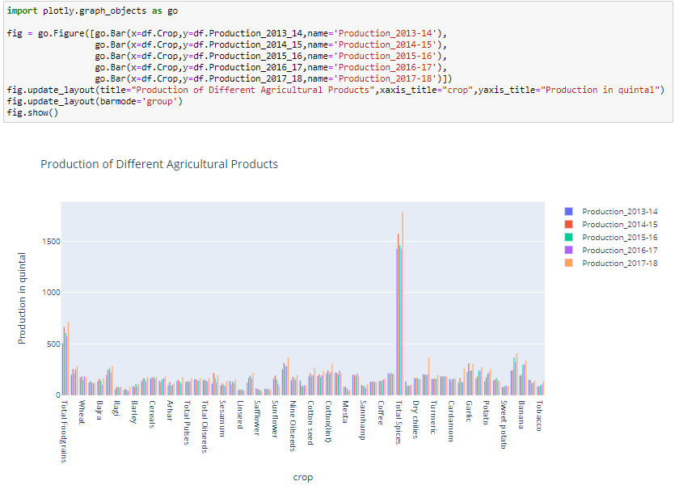

Slide 7
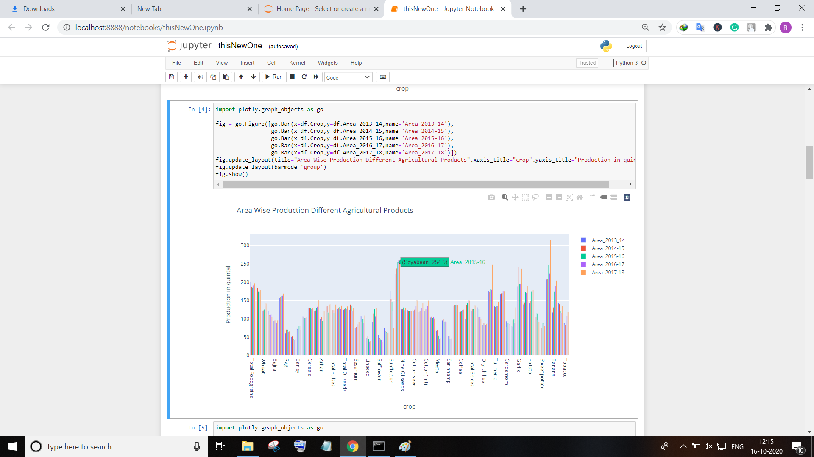

Slide 8
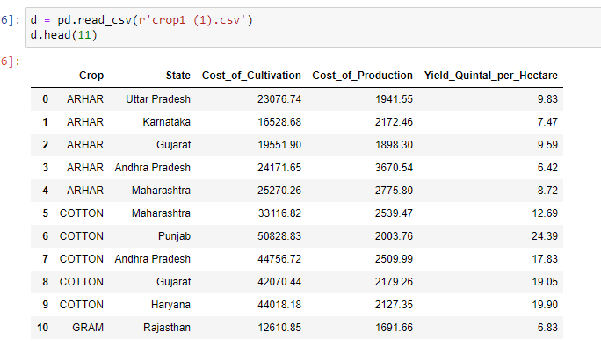

Slide 9
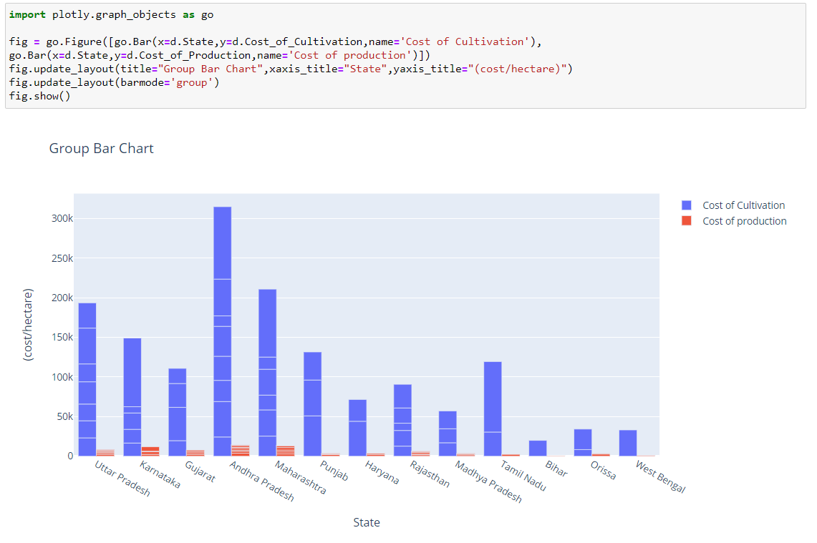

Slide 10
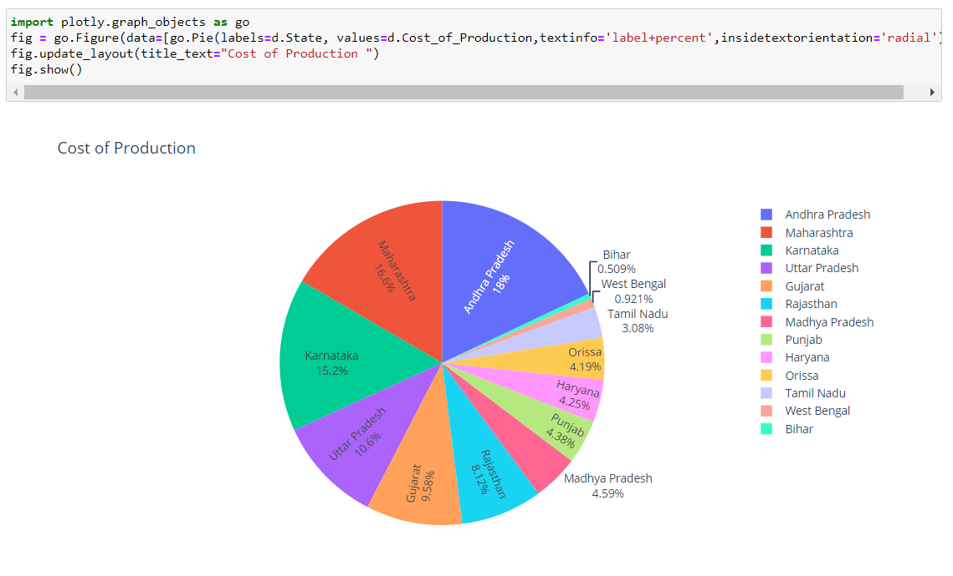

Slide 11
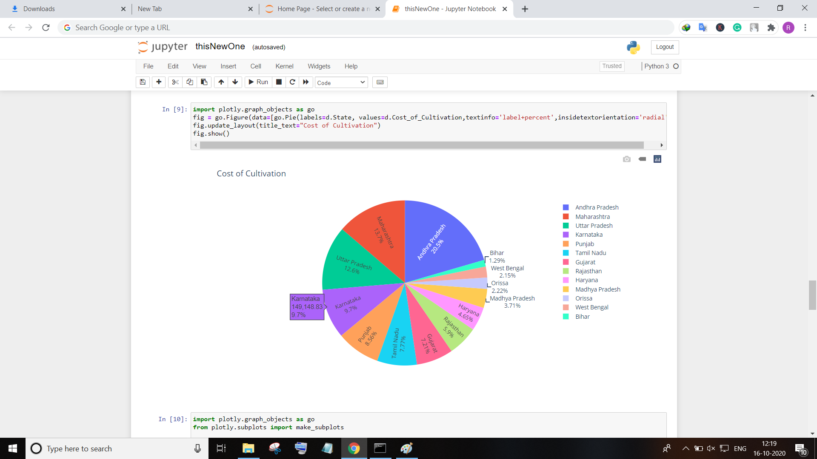

Slide 12
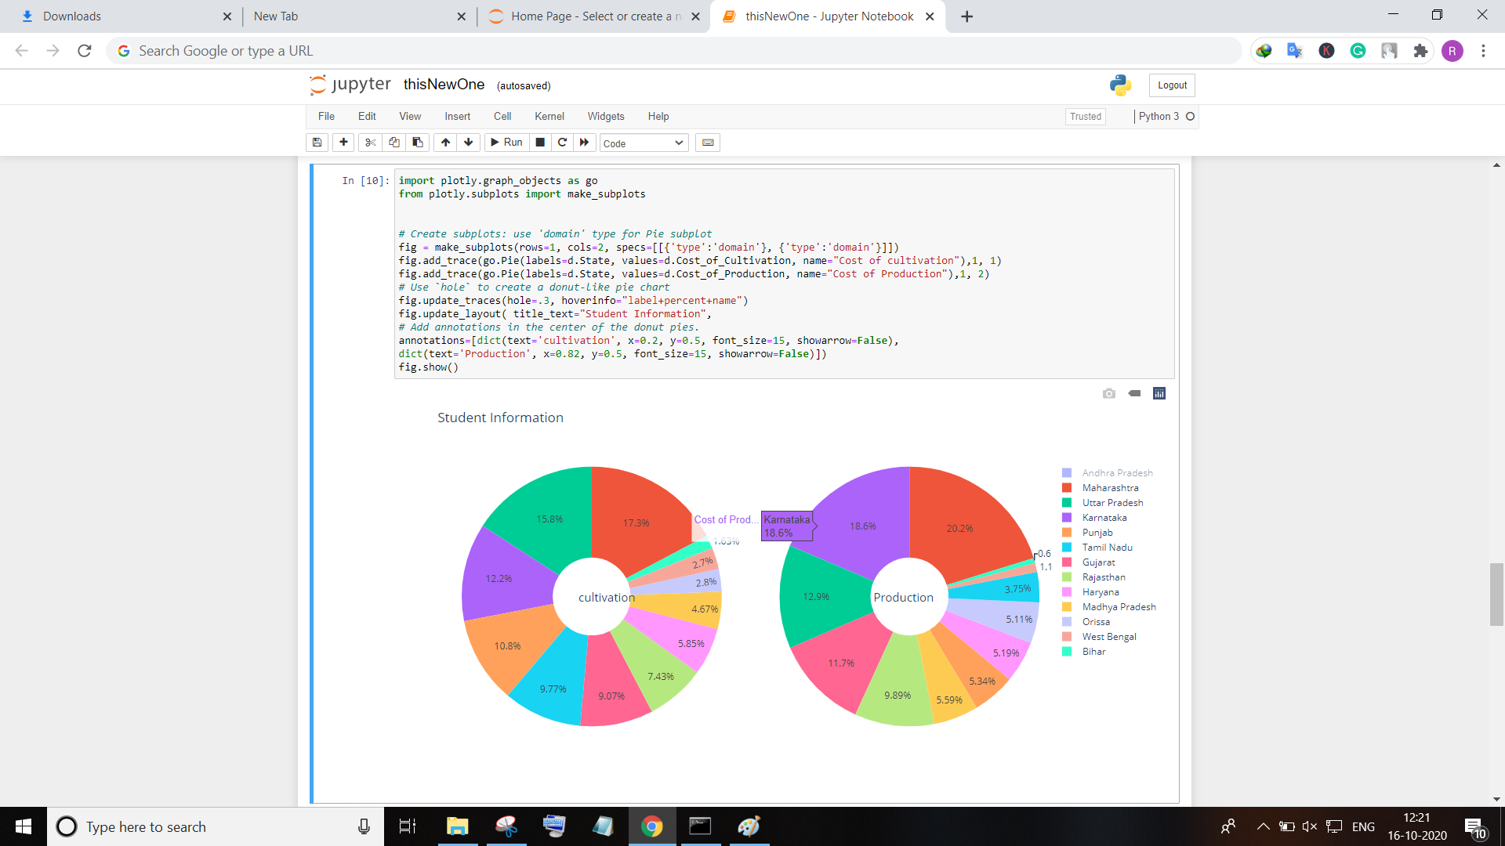
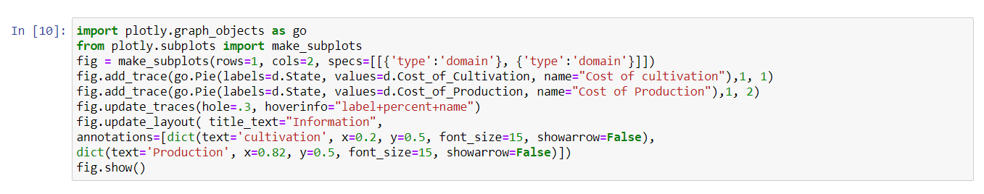

Slide 13
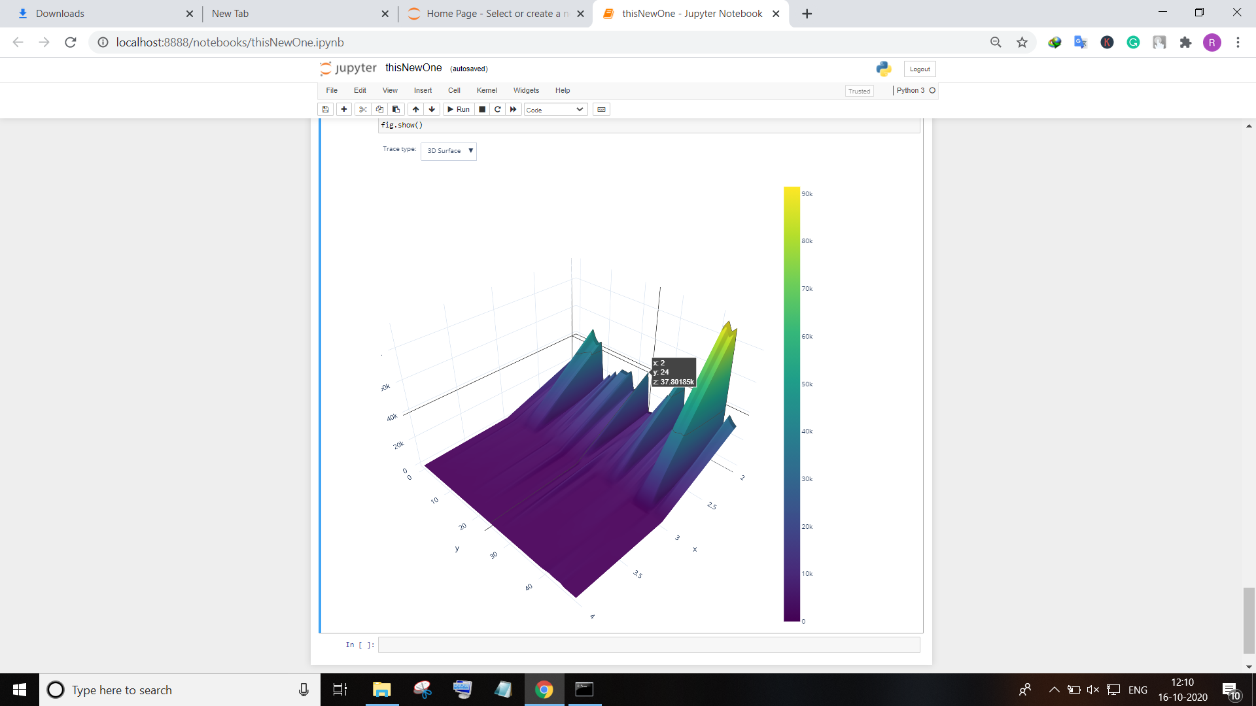

Slide 14
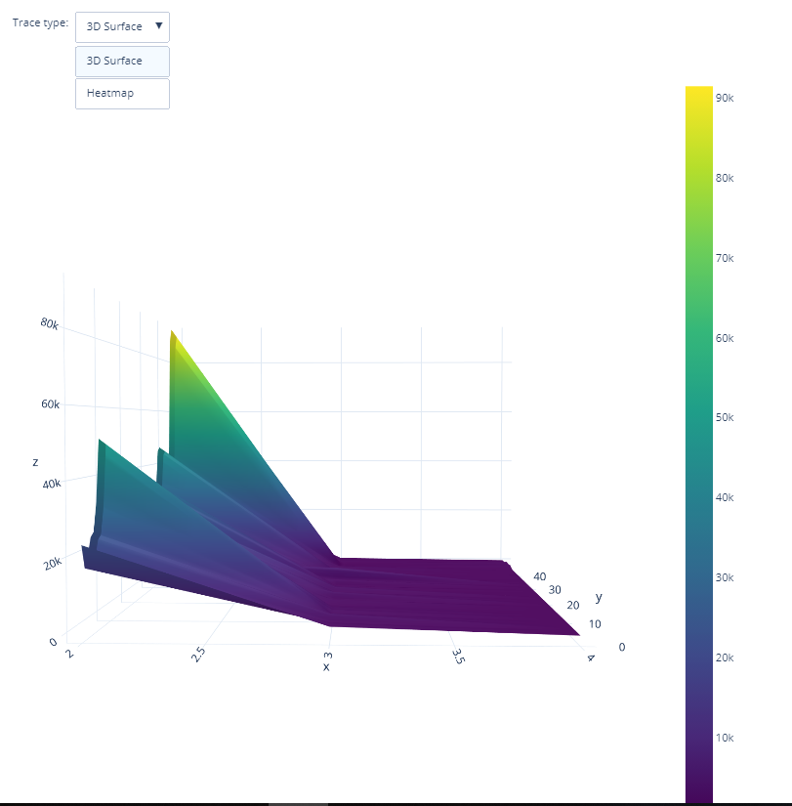

Slide 15
Hypothesis Developed:
  Getting Year wise Production Growth (in Increase and Decrease Analysis) & State wise variations in crop production cost.

Slide 16

Reference :
(1)-https://data.world/indoagri/indian-year-wise-crop-production
(2)-https://data.world/indoagri/indian-states-wise-crop-production

